Slide 1

Quantum Communications Group
Weekly Report
Supervisors:
Armando Nolasco Pinto
anp@ua.pt
Diogo Matos
dftm@ua.pt

Slide 2
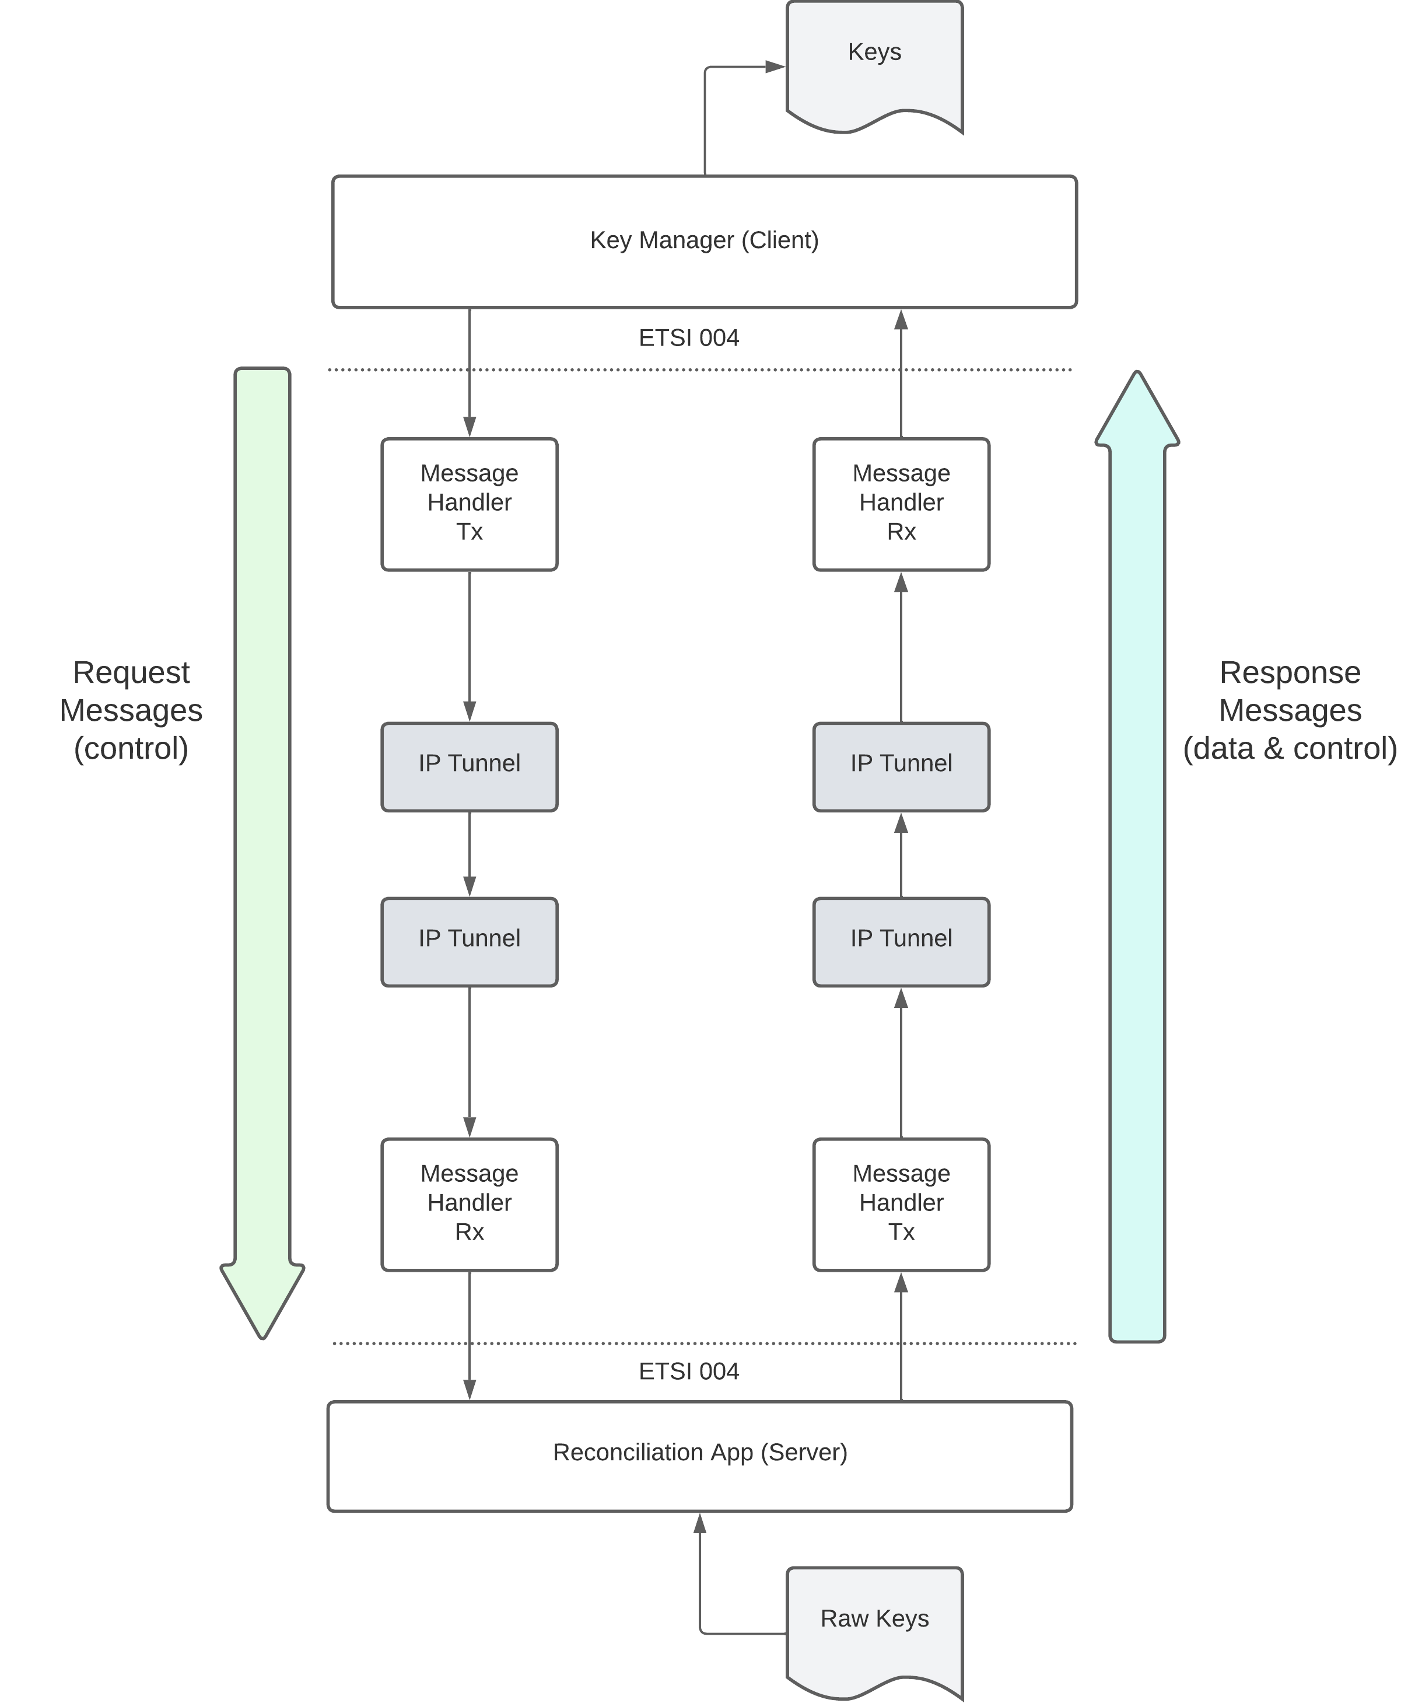
Diagram for the South interface
The interface between the Key Manager and the Reconciliation App is based on ETSI QKD 004 in push mode (the KMS is always receiving keys without making individual requests for each one).
The KMS will start by making an OPEN_CONNECT request to create a connection to the Reconciliation App. Then does one GET_KEY request and from that moment forward it will receive key material with the characteristics and pace specified in the QoS field until it makes a CLOSE request to terminate the key stream.

Slide 3
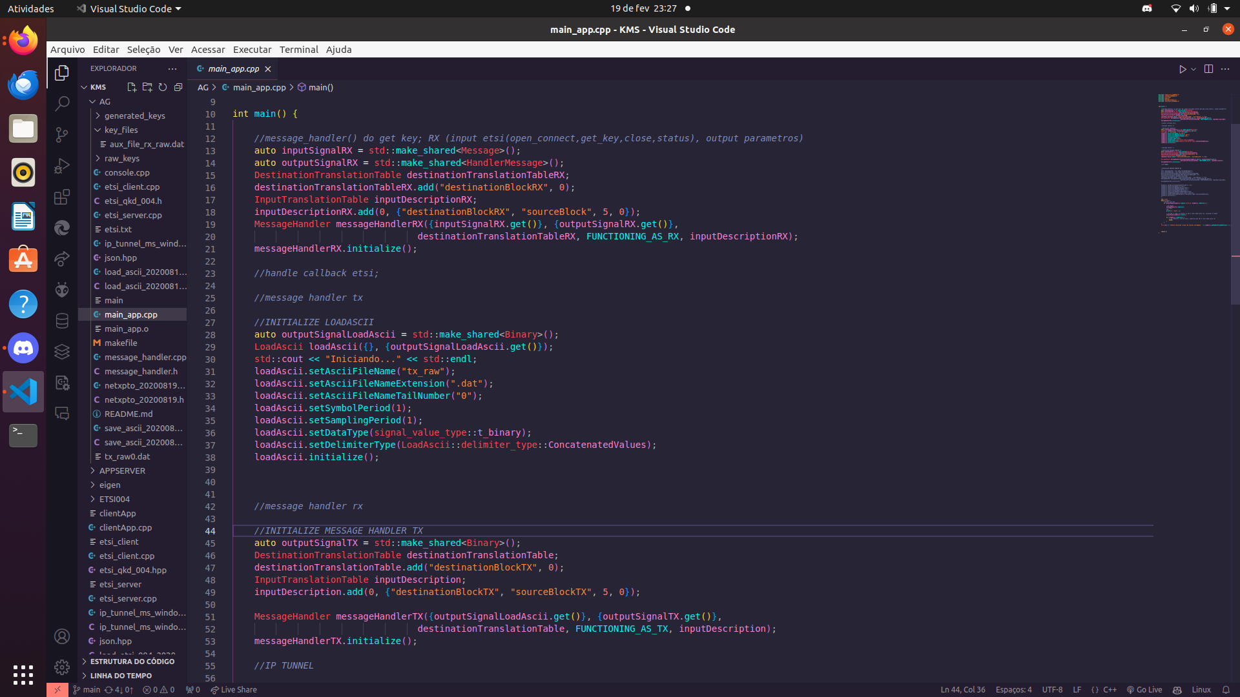
Server app
We already had the app reading files, we managed to transmit it through messange_handler, but now we need to use etsi communication and also to test, we managed to open the keys using saveascci
It remains to implement the etsi interface and iptunnel
Notes:
O que falta é implementar a interface etsi

Slide 4
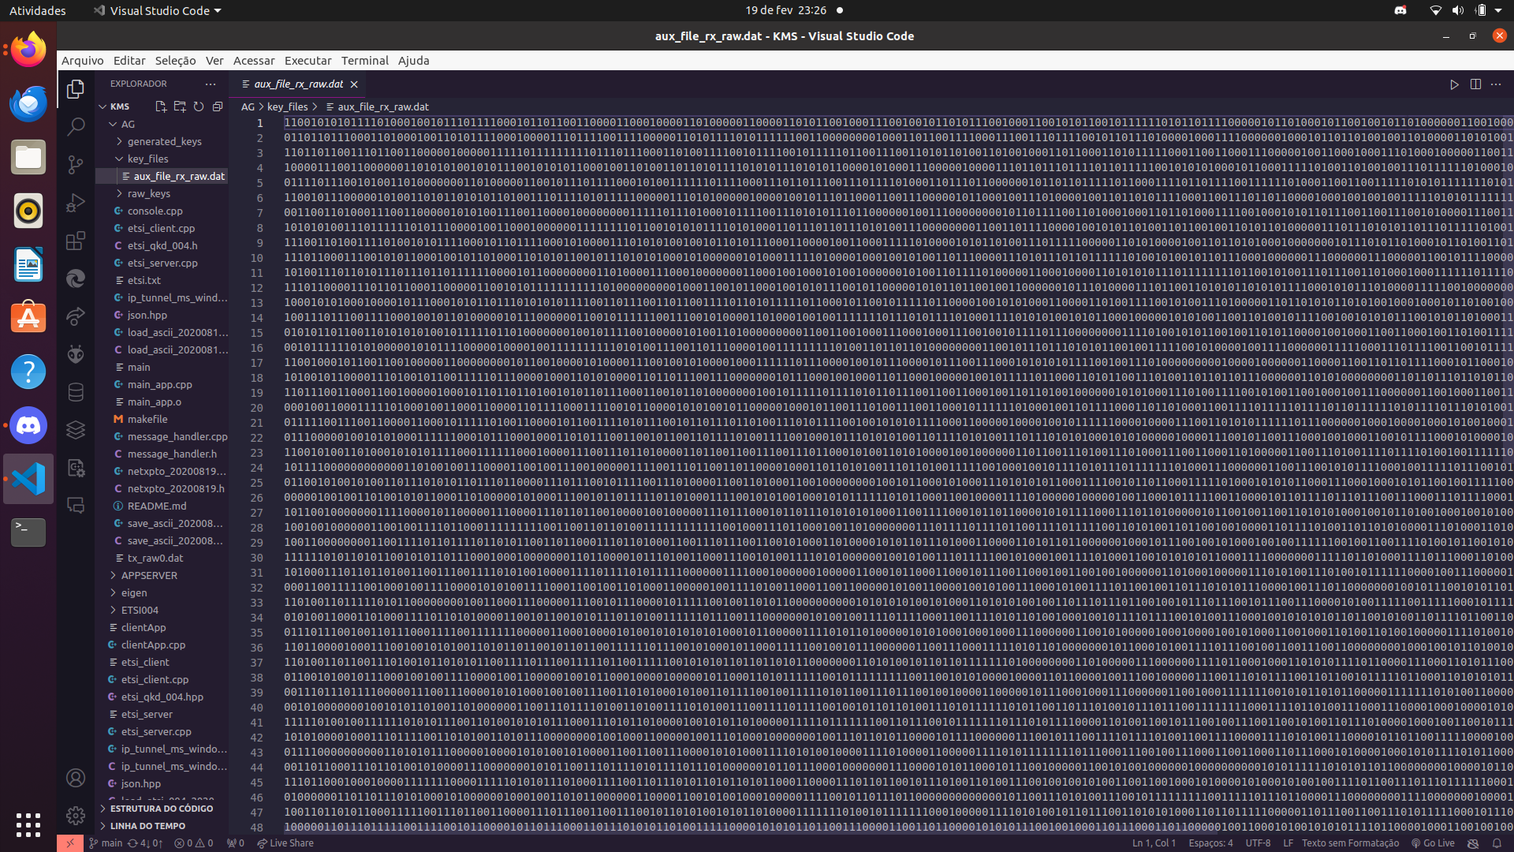
Server app
Notes:
We tried to implement 2 apps using a client-server approach. The client sends an open_connect request to the server and when the connection is established it sends a get_key request. After receiving 10 successive keys it closes the connection with a close request. We are having difficulties with the usage of the message_handler block and the ETSI 004 implementation.

Slide 5
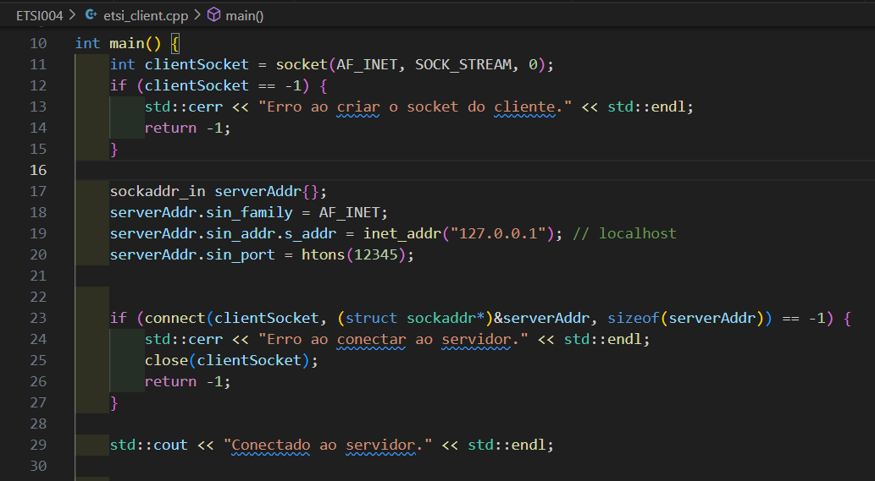
etsi_client.cpp
Program that establishes a socket connection with the etsi_server.cpp When the connection succeeds, the message "Conectado ao servidor" appears.

Slide 6
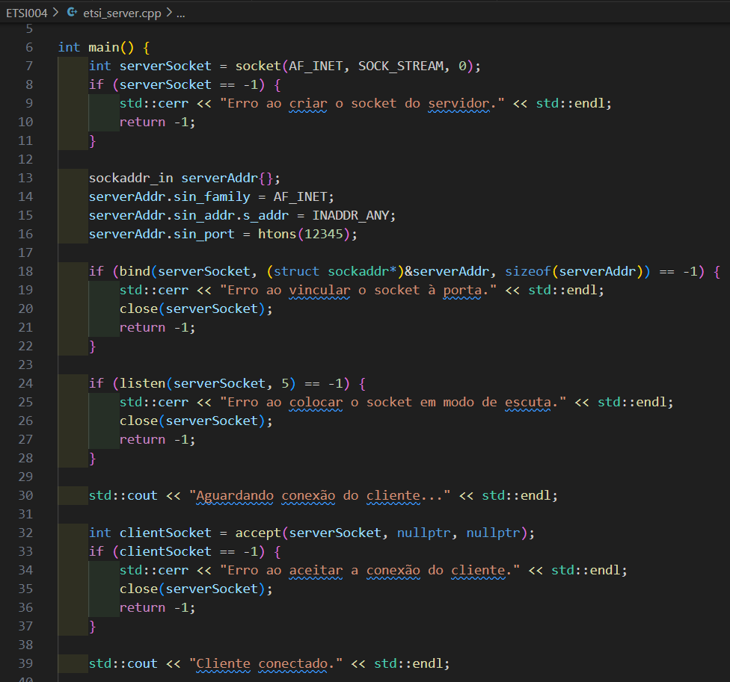
etsi_server.cpp
Program that establishes a socket connection with the etsi_client.cpp When the connection succeeds, the message "Cliente conectado" appears.

Slide 7
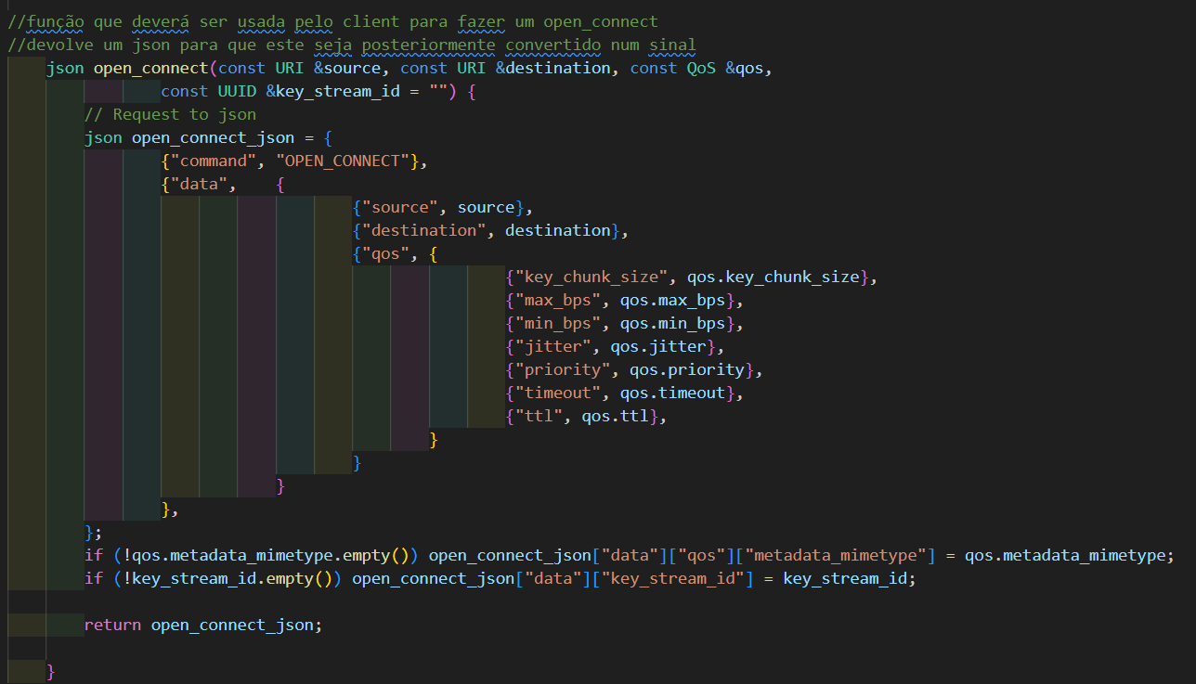
Functions used by the client app according to the ETSI library (etsi_qkd_004.h)
3 functions used by the client to send requests to the server:
open_connect
get_key
close
Each function returns a json with the needed parameters that is sent to the server.
Those json messages must be converted into a signal that is going to be the input of the Message Handler Transmitter (Client --> Server).

Slide 8
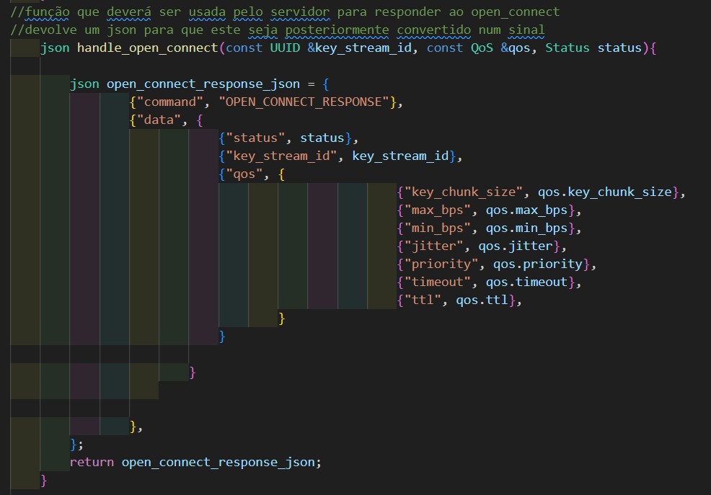
Functions used by the server app according to the ETSI library (etsi_qkd_004.h)
3 functions used by the server to create the response messages:
handle_open_connect
handle_get_key
handle_close
Each function returns a json with the needed parameters that is sent to the client (with the response).
Then, those json messages need to be converted into a signal that is sent to the Message Handler Transmitter, in the opposite direction (Server --> Client)

Slide 9
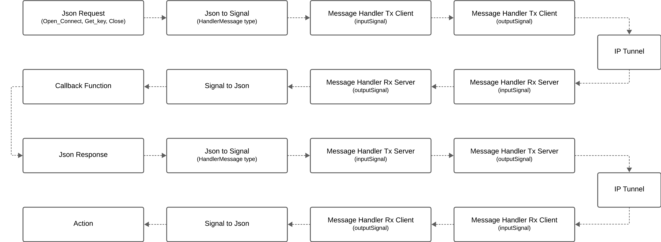
South Interface Flow

